Slide 1

State Aid Through the Lens of the Governor’s Executive Budget
February 15, 2024

Slide 2
Panelists
Cindy Gallagher, Director of Government Relations, SAANYS
Brian Cechnicki, Executive Director, ASBO New York
  8 years with Division of the Budget Education Unit
  1 year with Governor’s Office
  6 years with NYSED as Director of Education Finance

Slide 3
What is the impact of the proposed cuts?
Statewide: $168M from 337 districts (half of all districts!)
One-third in Suffolk, Nassau, Westchester, Rockland, and Putnam Counties; Two-thirds in rest of state
$34 million in High Needs districts; $96 million in average need
As a percent of Total General Fund Expenditures, cuts range from 0% to 12%
  32 districts have a cut-of-TGFE of 5% or more

Slide 4
Overview
Brief Overview of School Finance
What Should You Be Thinking About (SBO perspective)?
Reading the State Aid Run
Considerations about State Aid Amounts
Quick Deep Dive on Foundation Aid and Save Harmless

Slide 5
School District Revenue Sources
2019-20 School Year; Source: NYSED Analysis of School Finances in New York State

Slide 6
Not All Districts are Alike…
High-Need Urban District
Low-Need Suburban District
Source: 2019-20 School Year; NYSED Fiscal Profiles of School Districts

Slide 7
School District Revenue Sources
2022-23 School Year; Source: NYSED School Aid Database – Enacted Budget

Slide 8
What Should You Be Thinking About Right Now?
Impact Determination
Planning
Communication
Collaboration
Future State Budgets

Slide 9
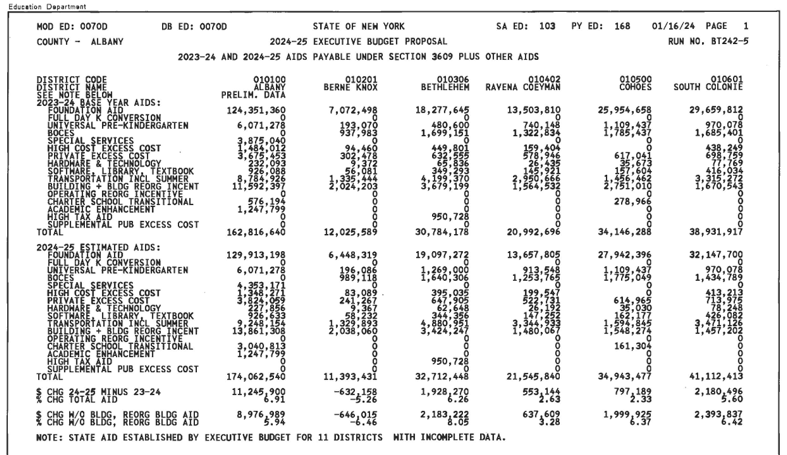
Reading State Aid Runs

Slide 10
Reading State Aid Runs

Slide 11
Reading State Aid Runs

Slide 12
Reading State Aid Runs

Slide 13
Reading State Aid Runs

Slide 14
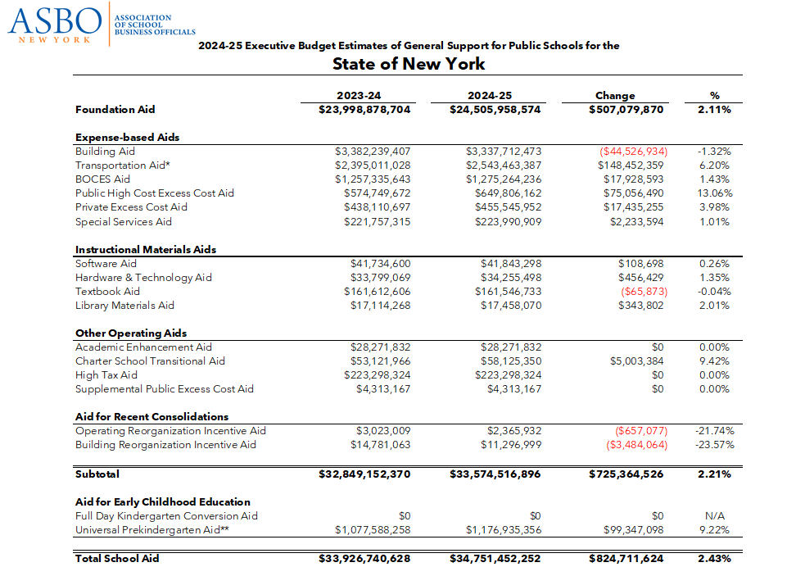

Slide 15
Reading State Aid Runs
November “Current Law”: SED publishes first estimates of the coming school year based on what is currently in law
Executive Budget State Aid Run: Includes changes that Governor is proposing
If the Governor proposes something less than “current law” only her proposal will show in the Executive Budget

Slide 16
Foundation Aid
Foundation Amount
Pupil Needs Index
Regional Cost Index
Expected Minimum Local Contribution
Foundation Aid Per Pupil
Governor’s inflation proposal reduces the “foundation amount” for all districts
The Save Harmless reduction reduces the overall aid amount for half of all districts

Slide 17
Why are districts on Save Harmless?
Foundation Aid currently protects districts from receiving less aid than the prior year, even if the formula calculation has declined
Why would the calculation decline?
  Decrease in the aid per pupil
  Decrease in enrollment (“TAFPU”)
  Change in other factors

Slide 18
Example in a High Need Rural District
 | 2007-08 | 2024-25 | Change
Selected Aid Per Pupil | $4,900.00 | $6,800.00 | +$1,900.00
Selected TAFPU | 1,400 | 900 | - 500
Enrollment | 1,100 | 700 | - 400
Selected Aid Per Pupil is the Greater of the “IWI” Calculation or the “SSR” Calculation
Selected TAFPU is a weighted enrollment count that includes the 1.41 special education weighting, smoothed over two years
Enrollment is the actual number of students

Slide 19
Example in a High Need Rural District

Slide 20
Considerations About State Aid Amounts
Foundation Aid
Expense-based Aids
Tax Cap
Save Harmless

Slide 21
How does the Executive Budget calculate the proposed cuts?
Save Harmless is reduced for all districts between 9% and 50%
No statutory “phase-out”—but the writing may be on the wall

Slide 22
How real are these cuts?
State Budget Gap
“Budget dance”?
We’ve seen cuts before—2003-04, 2011-12; this time different—there’s a tax cap, sustained high inflation, state not currently in a recession, staff shortages across the board
Even if restored this year…the conversation about Save Harmless and enrollment declines is here to stay

Slide 23
Thank You!
schoolbiz.info

